Slide 1
Prevention and Response to Active Shooter/Killer
Instructor

Slide 2
“The first problem is not what we do when the bad guys get into the classroom, but rather how we keep them out in the first place.”
“Once the bad guy gets into the classroom, we are left with nothing but bad options.’
- Lt. Col. Dave Grossman
Notes:
Instructor notes: Open with a quick comment that once the shooter starts shooting, people will start dying, so the best remedy is prevention.

Slide 3
Terminal Objective Part I
Upon completion of this module, the participant will be able to identify the active shooter/killer threat to schools including the goals and tactics of the attackers. The participant will also be able to describe the emergency management model for prevention and response to an active shooter/killer.

Slide 4
Enabling Objectives
Identify the five components of the campus community active shooter prevention and response process
Identify the five components to the emergency management cycle
Discuss the six components of campus prevention/mitigation/and preparedness from violent behavior
Describe the various types of active shooter threat goals and tactics

Slide 5
What Must We Do?
Deter
Detect
Delay
Disengage*
Defeat
Lt. Col. Dave Grossman (2010)
* Steve Ramirez (2011)

Slide 6
Campus Community Preparation & Response to Violent Threats Emergency Management Model
Notes:
Instructor note: Tell the students that the Campus Community Preparation & Response to Violent Threats Emergency Management Model includes:
Prevention/Mitigation
Preparedness
Response
Recovery
SBLEs can be involved in all of these areas.

Slide 7
Campus Community Preparation & Response to Violent Threats Emergency Management Model
Prevention
Mitigation
Preparedness
Response
Recovery
Notes:
Prevention
Mitigation
Preparedness
Response
Recovery
The National Incident Management System (NIMS) defines preparedness as "a continuous cycle of planning, organizing, training, equipping, exercising, evaluating, and taking corrective action in an effort to ensure effective coordination during incident response." This 'preparedness cycle' is one element of a broader National Preparedness System to prevent, respond to, recover from, and mitigate against natural disasters, acts of terrorism, and other man-made disasters.
The Department of Homeland Security/Federal Emergency Management Agency supports preparedness by developing policies, ensuring adequate plans are in place and are validated, defining necessary capabilities required to address threats, providing resources and technical assistance to jurisdictions, and integrating and synchronizing preparedness efforts throughout the Nation.

Slide 8
Mitigation/Preparedness
Threat Assessment
Physical Safety/Security
Cultural Safety/Security
Information/Intelligence
Communications
Emergency Management
Notes:
Instructor note: Ask the students for example what they think these things are in their school environment. (Very brief)
The next few slides will go more in depth.
Threat Assessment
Physical Safety/Security
Cultural Safety/Security
Information/Intelligence
Communications
Emergency Management

Slide 9
Threat Assessment
Threat Assessment Plan
Threat Assessment Group
Counseling/Health Services
Employee Assistance Program
Code of Conduct/Disciplinary Referral
Community Awareness/Reporting
Emergency Notification
Joint Information Center
Victim/Family Assistance
Notes:
Share with the SBLEs/students that these are components of a good “Safety net” to try and catch potentially dangerous behavior precursors. Ask them to take note of if they are aware of these components in their schools.

Slide 10
Physical Safety/Security
General Safety/Security Environment
Fire/Emergency Medical
CCTV Surveillance/Alarms/Monitoring
Architecture/Landscaping
Access Control
Notes:
Self explanatory slide -ask the students to consider and note what their impressions are of how their schools are currently prepared in the way of physical security.

Slide 11
Cultural Safety/Security
Situational Awareness
Active Empowerment
Effective Communications
Notes:
Self explanatory slide
Situational Awareness – discuss the situational awareness of current American culture. (Walking while texting, not paying attention to surroundings) What can we do to improve this. How aware are the officers to their surroundings when they go into the community on or off duty?
Active Empowerment –discuss current American cultural inclinations about taking ownership of our own safety.
Reactive – waiting for the police to save you vs.
Proactive –making safer choices, paying attention, being able to disengage or defend yourself.
Effective Communications – Examples: campus community alert systems, emergency communications

Slide 12
Communications Philosophy
Ensure Effectiveness of:
Internal Communications
External Communications
Notes:
Self explanatory slide
Internal Communications - How do you communicate within the school (students, faculty, staff, administration)? Police radio dispatch, cell phones, messaging systems, message boards, intercom systems, web-sites, social media, printed materials… ect.
External Communications – how do you communicate with the outside world? (Parents, Citizens/Public, other government entities, the PRESS!) web-sites, social media, telephones..ect.

Slide 13
Communications
Emergency Telecommunications
Public Information
Web-Site Development and Application
Social Media
Notes:
Self explanatory slide
Emergency Telecommunications –what systems do the SBLEs have in place at their schools? Police Dispatch 24/7, Emergency Alert systems…other?
Public Information - How do the SBLEs and the Independent School district/Local School communicate wit the general public?
Web-Site Development and Application/Social Media – This is a powerful tool for interactive communications with the campus community and the public. Web sites can be used as a portal for parents to go to during emergencies to get information and directions about the incident, the steps being taken to protect and care for students, and the reunification location where parents should go to collect their students. These sites can also be used as a means to communicate with students about safety and security and for students and parents to report concerns.

Slide 14
Emergency Communications
Redundancy
Regular Testing
Automatic Enrollment
Staff Training
Timely
Target Specific
Secure
Notes:
Emergency Communications Systems must have:
Redundancy - Back up systems including some that do not depend on technology.
Regular Testing –the communications plan and technology should be tested regularly and problems should be addressed.
Automatic Enrollment –Emergency notification systems are most effective if all students, faculty, and staff, are automatically enrolled and they have to take action to opt-put of the system rather than opt-in.
Staff Training –staff must be trained on how to use the systems
Timely – they must be able to communicate emergency information in a timely manner
Target Specific – it is best if individual parts/building/sectors of the community can be targeted. For example: if a building is on fire and toxic chemicals are coming out in the smoke, one area of the campus might need to be evacuated while the other might best be protected via sheltering in place.
Secure –not prone to cyber-hacking

Slide 15
Redundancy
Phone Notification
Message Boards
Voice Notification
Computer Network Notification
Campus TV/Radio
Campus Newspapers/News Letters
Notes:
All of these items build on each other so that if one fails the other is a back up.

Slide 16
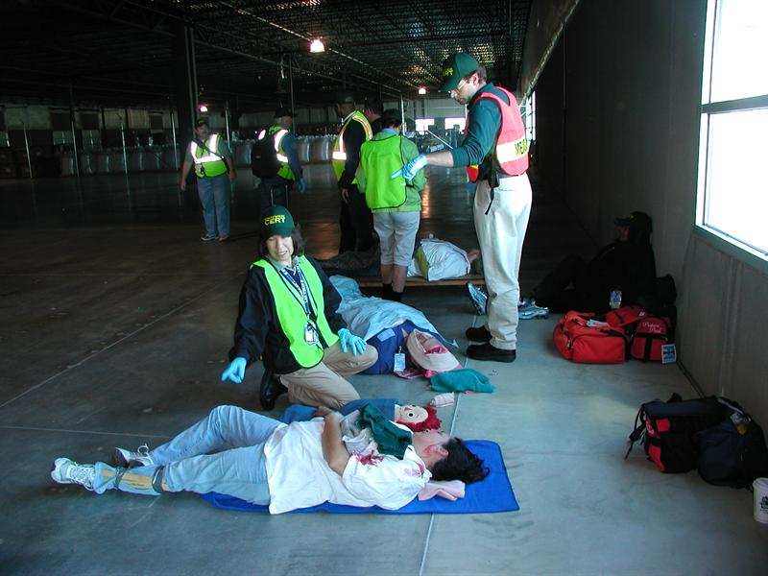
Emergency Management
“All Hazards” or “Multi-Hazard” approach
Planning
Training
Exercising
Notes:
Emergency Management takes an “All Hazards” or “Multi- Hazard” approach, so that we are preparing to have the capabilities that will be needed for any emergency. The capabilities required for disasters are much the same not matter what kind of disaster it is: hurricane, fire, tornado, gas leak, active shooter/killer. The one exception to this is that any criminal act like active shooter/killer includes a crime scene as part of the Recovery Phase whereas a natural disaster does not.
The three key components of Emergency Management are:
Planning –creating your school emergency operations plan (EOP)
Training -training in all aspects of the plan and the skill sets it take to effective respond to incidents.
Exercising – conducting drills and exercises to test how well the planning and training is working.
Instructor Note: Ask the SBLEs if they are doing all three at there school.

Slide 17
Emergency Operations Center
Location Identified
Power and Utilities
Communication
Security
Emergency Management (NIMS/ICS)
Notes:
Self explanatory slide
These are aspects of the setting up an emergency operations center:
Location Identified – Pre-Identify and primary and secondary EOC location and ensure that all who will need to report to it during an event/incident know where the location is.
Power and Utilities – Does it have power and back up generator capabilities?
Communication –Does it have proper/effective communications technology/ability on site?
Security –Is it secure and safe? Can you keep press and other non-essential personnel away fro the EOC?
Emergency Management (NIMS/ICS) – does it meet the requirements of NIMS/ICS operations?

Slide 18
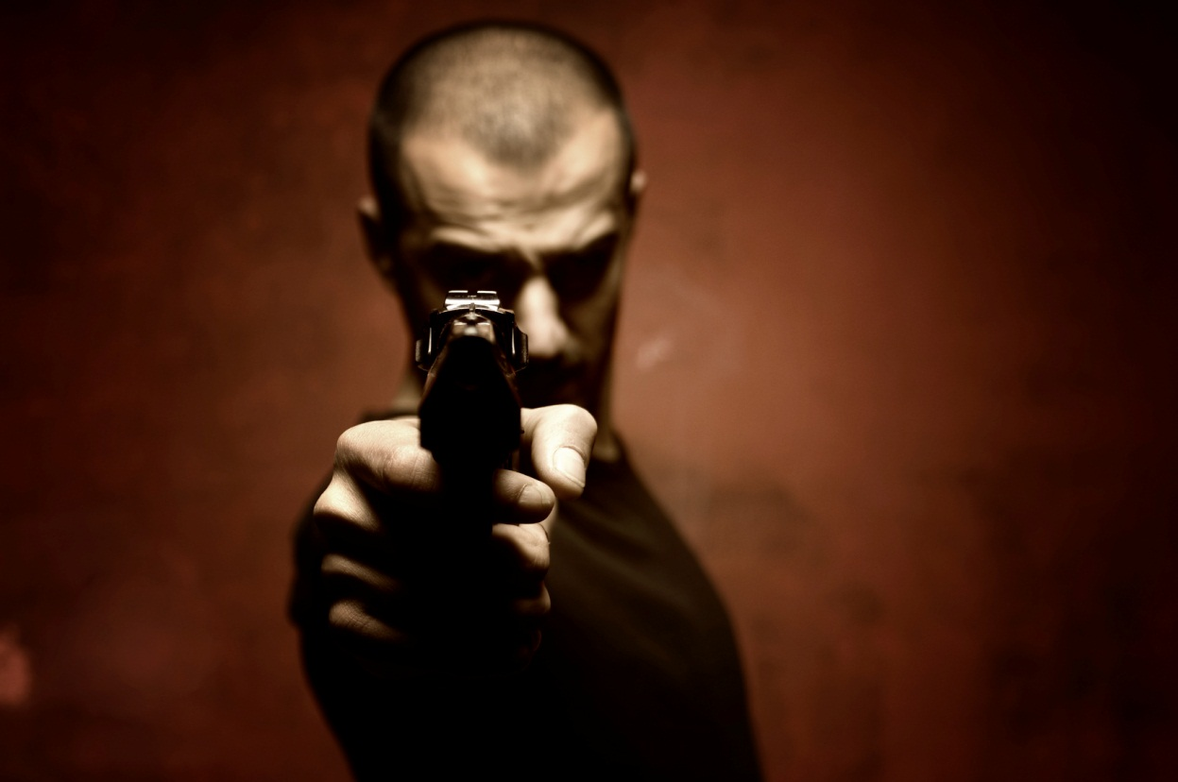
Understanding the Threat (Active Shooter/ Killer)
What is the “profile” of a school shooter/killer?
Notes:
Instructor Note: Ask the class… do they thing there is or is not one primary profile of an active shooter/killer?

Slide 19
One Size Does Not Fit All
Focus on Tactics… Not Who it Might Be
Limited Number of Tactics
Target Often Dictates Tactics
Understand the Goals of the Attack
-John Giduck (2010)
Notes:
Answer: there is no one single profile of an active shooter killer that might attack a school. Since there are a number of possible profiles, we can most effectively combat and detect, deter, delay and attack by focusing on the tactics used.

Slide 20
Understanding the Threat (Active Shooter/ Killer)
Single Student Shooter
Low # Student Shooters
High #/Multiple Student Shooters
Young Adult Shooter
Adult Shooter
Terrorist Attack (Al-Qaeda)
Notes:
Instructor note: point out the list of various active shooter/killer profiles and that we will be looking at each in a more in-depth manner.

Slide 21
Potential Attack Methods
Active Shooter/Decimation Assault (Columbine/Virginia Tech) “Enthusiastic Amateurs”
Mass Hostage Siege (Beslan)
Hybrid/Synergy (9-11)
Symphonic (Mumbai)
-John Giduck (2010)
Notes:
By understanding attack methods, we can better understand the capabilities we as SBLEs must have in order to detect, deter, delay, and defeat the active shooter/killer in a school.

Slide 22
Single Student Shooter (Examples)
Teen Is Held in Deadly School Shootings; Slayings: 14-year-old boy used high-powered rifle to kill teacher, two students, police say. The violence leaves a tiny Washington community in shock. (Moses Lake, 1996)
OMAHA, Neb. -- An angry online posting from the 17-year-old boy who opened fire at a Nebraska high school, fatally wounding an assistant principal before later killing himself, offers some clues about why the son of a police detective turned violent a couple of months after transferring there. ( 1/05/2011)

Slide 23
Single Student Shooter (Tactics)
Specific Target(s)
May be preceded by a catalytic event such as expulsion/suspension/bullying
Not Planning to Fight Police (Suicide)
Notes:
Instructor note: Point out the tactics of the Single Student Shooter. Since this type of active shooter/killer (ASK) is usually focused on one or two specific targets a police response that limits the shooter ability to access targets will help mitigate the damage of the actor’s intentions.
A single SBLE/SRO can stop the shooter’s forward action and terminate the event via the shooter committing suicide.

Slide 24
Low# Student Shooters (Example)
Notes:
Discuss Columbine and how this was a planned incident with many general targets. Ask the SBLEs what they know about this incident and what they feel we have learned since then. (brief discussion)
The Columbine High School massacre (often known simply as Columbine) was a school shooting which occurred on April 20, 1999, at Columbine High School in Columbine, an unincorporated area of Jefferson County, Colorado, United States. Two senior students, Eric Harris and Dylan Klebold, embarked on a shooting spree in which a total of 12 students and 1 teacher were murdered. They also injured 21 other students directly, with three further people being injured while attempting to escape the school. The pair then committed suicide. It is the fourth-deadliest school massacre in United States history, after the 1927 Bath School disaster, 2007 Virginia Tech massacre and the 1966 University of Texas massacre, and remains the deadliest for an American high school.
The massacre provoked debate regarding gun control laws, the availability of firearms within the United States and gun violence involving youths. Much discussion also centered on the nature of high school cliques, subcultures and bullying, in addition to the influence of violent movies and video games in American society. The shooting resulted in an increased emphasis on school security, and a moral panic aimed at goth culture, social outcasts, gun culture, the use of pharmaceutical anti-depressants by teenagers, teenage internet use[1] and violent video games
http://en.wikipedia.org/wiki/Columbine_High_School_massacre

Slide 25
High #/Multiple Student Shooters (Examples)
Alaskan boys 'planned school massacre' Six 13-year-olds arrested in Santa Claus town Pupils allegedly plotted to cut power and phone lines.
RIVERTON, Kan. — Five teenagers suspected of plotting a shooting rampage at their high school will stay in custody through the weekend while prosecutors decide whether to file charges, a judge ruled Saturday.
Notes:
Instructor note: Read the overview of these tow examples and point out how young the actors were and ask, what the SBLEs think this means in altering their own expectations as to who can be a dangerous killer in their respective schools. Take note of the amount of planning implied in both these cases.

Slide 26
Multiple Student Shooters
Use Military Attack Plans
Ambush
“Hammer and Anvil” Attacks
IEDs
Use of Rear Guards
Predatory Response
Notes:
Instructor note. Go over the tactics of a multiple student shooter attack. Ask the SBLEs to consider how these tactics dictate their efforts to detect, deter, delay, and defeat the attackers.

Slide 27
Young Adult Shooter (Example)
Notes:
The Virginia Tech massacre was a school shooting that took place on April 16, 2007, on the campus of Virginia Polytechnic Institute and State University in Blacksburg, Virginia, United States. Seung-Hui Cho shot and killed 32 people and wounded 17 others[1] in two separate attacks, approximately two hours apart, before committing suicide. (Another 6 people were injured escaping from classroom windows.) The massacre is the deadliest shooting incident by a single gunman in U.S. history.[2] It was also the worst act of mass murder on college students since Syracuse University lost 36 students in the bombing of Pan Am Flight 103.[3] It is also the second-deadliest act of mass murder at a school campus, behind the Bath School bombing of 1927.
Cho, a senior English major at Virginia Tech, had previously been diagnosed with a severe anxiety disorder. During much of his middle school and high school years, he received therapy and special education support. After graduating from high school, Cho enrolled at Virginia Tech. Due to federal privacy laws, Virginia Tech was not informed of Cho's previous diagnosis or the accommodations he had been granted at school. In 2005, Cho was accused of stalking two female students. After an investigation, a Virginia special justice declared Cho mentally ill and ordered him to attend treatment.[4] Lucinda Roy, a professor and former chairwoman of the English department, had also asked Cho to seek counseling.[5] Cho's mother also turned to her church for help.[6]
The attacks received international media coverage and drew widespread criticism of U.S. laws and culture.[7] It sparked intense debate about gun violence, gun laws, gaps in the U.S. system for treating mental health issues, the perpetrator's state of mind, the responsibility of college administrations,[8] privacy laws, journalism ethics, and other issues. Television news organizations that aired portions of the killer's multimedia manifesto were criticized by victims' families, Virginia law enforcement officials, and the American Psychiatric Association.[9][10]
The massacre prompted the state of Virginia to close legal loopholes that had previously allowed Cho, an individual adjudicated as mentally unsound, to purchase handguns without detection by the National Instant Criminal Background Check System (NICS). It also led to passage of the first major federal gun control measure in more than 13 years. The law strengthening the NICS was signed by President George W. Bush on January 5, 2008.[11]
The Virginia Tech Review Panel, a state-appointed body assigned to review the incident, criticized Virginia Tech administrators for failing to take action that might have reduced the number of casualties. The panel's report also reviewed gun laws and pointed out gaps in mental health care as well as privacy laws that left Cho's deteriorating condition in college untreated.[1]

Slide 28
Young Adult Shooter (Tactics)
Hostages Unlikely
Not Planning to Fight Police (Suicide)
Trained on Video Games, Paintball, Range
Looking for a Higher Body Count (killing is easier with age)
-John Giduck (2010)
Notes:
Instructor note. Go over the tactics of a young adult shooter attack. Ask the SBLEs to consider how these tactics dictate their efforts to detect, deter, delay, and defeat the attackers.

Slide 29
Adult Shooter (Example)
Notes:
The Platte Canyon High School hostage crisis was an incident of a hostage taking and shooting that occurred at Platte Canyon High School in Bailey, Colorado, on September 27, 2006. The gunman, 53-year-old[1] Duane Roger Morrison entered the school building, claiming to be carrying a bomb. Morrison had been imprisoned in 1973 for larceny and possession of marijuana, and was arrested on a separate occasion for obstructing police in Littleton, Colorado.[2] He was initially reported as a bearded 35-year-old man with a camouflage backpack[3] and black hooded sweatshirt.[4] Morrison took six female students hostage and sexually assaulted them, later releasing four. When police broke open the classroom's door with explosives, Morrison opened fire with a semi-automatic pistol before shooting hostage Emily Keyes in the head. The other remaining hostage escaped unharmed, and paramedics confirmed that Morrison had committed suicide shortly before police were able to enter the classroom. Keyes was pronounced dead at 4:32 p.m. MDT (23:32 UTC) at Saint Anthony's Hospital in Denver, Colorado after undergoing emergency surgery.[5]
http://en.wikipedia.org/wiki/Platte_Canyon_High_School_shooting

Slide 30
Adult Shooter (Tactics)
Uses Tactical Barriers
Hostages
Has Primary and Secondary Attack Goals
Sexual Assault is Often a Secondary Goal
-John Giduck (2010)
Notes:
Instructor note. Go over the tactics of a adult shooter attack. Ask the SBLEs to consider how these tactics dictate their efforts to detect, deter, delay, and defeat the attackers. Take note of the secondary goal. How might it change the SBLE response knowing that sexual assault of hostages is a part of the plan?

Slide 31
Terrorist Attack (Al-Qaeda) Beslan

Slide 32
Terrorist Attack (Al-Qaeda) Beslan
Al-Qaeda Proving Ground for U. S. Attacks
49 Al-Qaeda/Chechen Terrorists
3 Days in Duration
Over 1200 Hostages including 777 Children
334 Civilians Killed including 186 Children
21 Rescuers Killed
Notes:
Give the overview of what happened at Beslan and point out that it was intended as practice for attacks on American schools.
The Beslan school hostage crisis (also referred to as the Beslan school siege or Beslan massacre)[2][3][4] of early September 2004 lasted three days and involved the capture of over 1,100 people as hostages (including 777 children),[5] ending with the death of over 380 people. The crisis began when a group of armed separatist militants, mostly Ingush and Chechen, occupied School Number One (SNO) in the town of Beslan, North Ossetia (an autonomous republic in the North Caucasus region of the Russian Federation) on 1 September 2004. The hostage-takers were the Riyadus-Salikhin Battalion, sent by the Chechen separatist warlord Shamil Basayev, who demanded an end to the Second Chechen War and Russian withdrawal from Chechnya. On the third day of the standoff, Russian security forces entered the building with the use of tanks, incendiary rockets and other heavy weapons.[6] At least 334 hostages were killed as a result of the crisis, including 186 children,[7][8] with a significant number of people injured and reported missing.
The event led to security and political repercussions in Russia, most notably a series of federal government reforms consolidating power in the Kremlin and strengthening of the powers of the President of Russia.[9] According to American non-governmental organization (NGO), Freedom House, these reforms consolidated Russia as a politically non-free, authoritarian state since the mid-2000s.[10][11] As of 2011, aspects of the crisis in relation to the militants remain contentious; including how many militants were involved, the nature of their preparations and whether a section of the group had escaped. Questions about the Russian government's management of the crisis have also persisted; including allegations of disinformation and censorship in news media, whether the journalists who were present at Beslan were allowed to freely report on the crisis,[12] the nature and content of negotiations with the militants, allocation of responsibility for the eventual outcome, and perceptions that excessive force was used.[6][13][14]
http://en.wikipedia.org/wiki/Beslan_school_hostage_crisis

Slide 33
Terrorist Attack (Al-Qaeda)
Attack Phase
Submission & Control Phase
Stabilization Phase
Fortification Phase
“Negotiation” Phase
“Rescue” Phase
Notes:
Instructor note. Go over the tactics of a terrorist attack. Ask the SBLEs to consider how these tactics dictate their efforts to detect, deter, delay, and defeat the attackers.
Attack Phase – Quick brutal attack is conducted to create fear and eliminate any opposition. Adult males are most often either killed in this phase or used to build fortifications and then killed.
Submission & Control Phase –fear is used along with a promise of safety in exchange for cooperation. It is a false promise.
Stabilization Phase –gaining control of the hostages
Fortification Phase –building fortifications to slow police entry
“Negotiation” Phase –negotiations are falsely offered in order to gain time for fortification and to gain greater media coverage.
“Rescue” Phase –action is taken such as killing hostages in order to force police action and cause greater casualties.

Slide 34
“Every hostage is a short term prisoner on their way to execution.”
- John Giduck (2010)
Notes:
Ask the SBLEs to consider this quote.
How do you tell the difference between a hostage situation that may end in no bloodshed via negotiations (domestic dispute) and an planned terrorist act where the hostages are only used as a stalling tactic.
How does this change the SBLE’s actions?

Slide 35
“Sheep have two speeds, graze and stampede.”
- Lt. Col. Dave Grossman
Notes:
Note that we need to engage our school community in the planning, training and exercising for an incident. We need to create an active safety and security culture, not a passive one.

Slide 36
What Do We Do
Deter
Detect
Delay
Disengage
Defeat
Notes:
Deter - Physical Safety/Security
Detect - Behavioral Assessment, Threat Assessment, Cultural Safety/ Security, Information/Intelligence
Delay – Lock Doors, Secure Area, Single Point of Entry
Disengage – Evacuation or Escape by any means
Defeat – Police Response or Targets Fighting Back (Capable Guardians)

Slide 37
Deter
Physical Safety/Security
Detect
Behavioral Assessment, Threat Assessment, Cultural Safety/ Security, Information/Intelligence
Delay
Lock Doors, Secure Area, Single Point of Entry
Notes:
Deter - Physical Safety/Security
Detect - Behavioral Assessment, Threat Assessment, Cultural Safety/ Security, Information/Intelligence
Delay – Lock Doors, Secure Area, Single Point of Entry

Slide 38
Disengage
Evacuation or Escape by any means
Defeat
Police Response or Targets Fighting Back (Capable Guardians)
Notes:
Disengage – Evacuation or Escape by any means
Defeat – Police Response or Targets Fighting Back (Capable Guardians)

Slide 39
“Denial has no survival value; it kills twice: physically and psychologically.”
-Lt. Col Dave Grossman
Notes:
Note that we must understand the possible threats to our schools including balancing the frequency vs, impact of the possible threat. We must them engage our communities to plan, train, and exercise to be prepared for the possible incident. Emphasis needs to be placed on the fact that prevention is the best SBLE tactic!

Slide 40
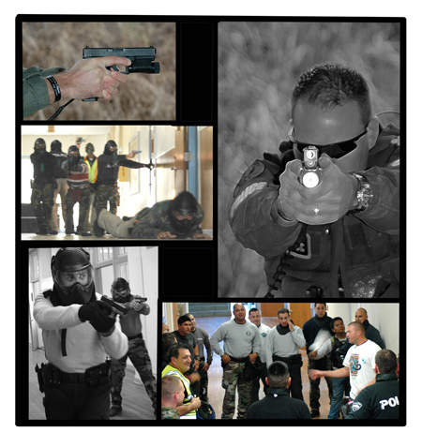
The Police Response Part II (Defeat the Threat)
This Section of SBLE I Training is based upon on the curriculum of the Advance Law Enforcement Rapid Response Training Center, http://alerrt.org/ and is presented in partnership with ALERRT.

Slide 41
Terminal Objective Part II
Upon completion of this module, the participant will be able to demonstrate knowledge of:
Basic firearms safety, proper grip and stance, and moving and shooting principals
Threshold evaluation/slicing the pie technique
Team movement techniques from solo officer entry to five officer teams.
Setting up and conducting a room entry as a solo responder and in a team of up to five responders.

Slide 42
Hostage Barricade vs. Active Shooter

Slide 43
Hostage Barricade
The 5 Cs are:
Contain
Control
Communicate
Call SWAT
Create a Plan

Slide 44
Active Shooter/Killer
Unlike the hostage barricade, the active shooter is normally a planned event with the goal of killing as many innocent people as possible
If the hostage taker starts killing innocent hostages, responders should have a plan to enter, close distance, and neutralize the threat.

Slide 45
Enabling Objectives Part II-A
Identify and demonstrate the four universal firearms safety rules
Demonstrate the high friction grip on a handgun
Demonstrate the modified low ready/combat ready position
Demonstrate the “sul”/“safety circle” position
Demonstrate proper body positioning when moving and shooting
Demonstrate and discuss the contact/cover principal
Demonstrate and discuss priority of fire concept
Discuss the importance of follow through, scanning, and breathing during lethal force encounters

Slide 46
Weapons Manipulation
Universal Firearms Safety Rules
Two-handed “High Friction” Grip
Modified Low Ready/Combat Ready Position (traveling position)
Position Sul or Safety Circle (used with Known Friendlies in down range)
Universal Fighting Stance
Proper Body Position
Movement
Notes:
Universal Firearms Safety Rules
#1: Treat all weapons as if they were loaded.
“Perfect Practice Makes Perfect”—Handle your training weapon as if it were your duty weapon.
#2: Keep your finger OFF the trigger until you have positively identified a threat and have made a decision to engage.
“Index Trigger Finger”—Index your trigger finger outside the trigger guard and along the frame of the weapon. Your finger should only move to the trigger when you identify a threat and must take immediate action. After neutralizing a threat and completing follow through, return to the index position before scanning or moving.
#3: Never let your muzzle cover anything you are not willing to kill or destroy.
“Laser Rule”—Imagine a laser coming from the muzzle of your weapon and extending to the maximum range of the weapon system. At no time should your laser ever touch any part of a teammate’s body or anyone you do not suspect of being a threat to yourself or a third person. The muzzle should stay below horizontal at all times unless engaging an elevated threat or covering an elevated threat area (for example, a stairway).
#4: Know your arc of fire.
Maintain situational awareness of your bullet’s path from the muzzle of your firearm to the target and beyond in the event you miss or the bullet over penetrates the threat.

Slide 47
First Responder Issues
6’ Reactionary Gap
Lower Weapon to Open Visual Field
Priority of Fire
Contact Cover Principle
Notes:
Position Sul or Safety Circle (used with Known Friendlies in down range)
Sul (pronounced sool, Portuguese for south) or safety circle is one of the safest positions when moving in and around large groups of people that are not a threat. Starting with the handgun in a proper two hand grip from a low or combat ready position, release the grip of your support hand. Rotate the weapon’s muzzle down while positioning the support/off side of the weapon on the back of your support hand. Place the palm of your support hand on your upper abdomen or sternum. Your muzzle should be pointing straight down toward the ground and your laser should stay approximately 18–24 inches in front of your feet.

Slide 48
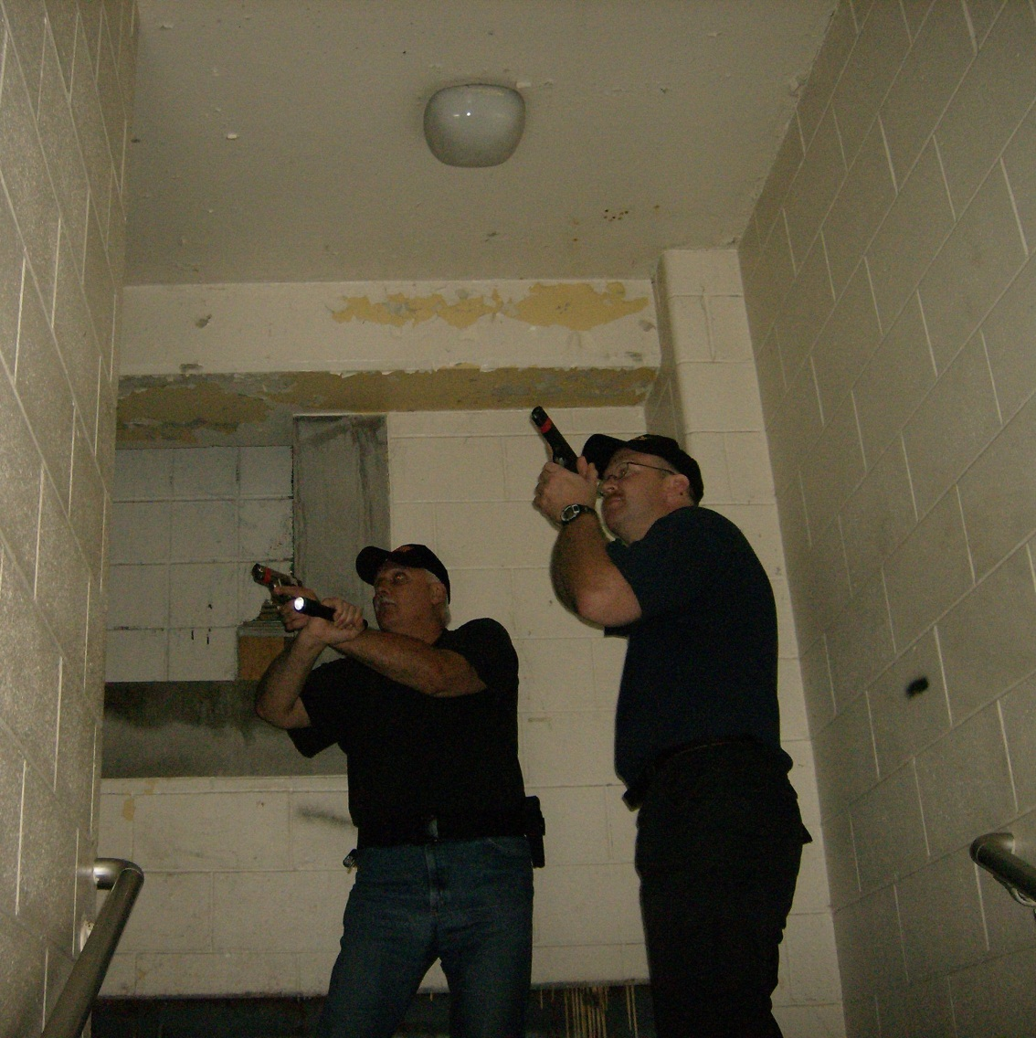
Follow Through, Scan, and Breathe
Follow Through
Scan
Breathe

Slide 49
Enabling Objectives Part II-B
Demonstrate safe weapons handling skills
Identify the purpose of conducting the threshold evaluation/slicing the pie technique
Demonstrate the threshold evaluation/slicing the pie technique moving at a slow, deliberate speed
Discuss and demonstrate the three methods of communication with their partner while conducting the threshold evaluation/slicing the pie technique
Demonstrate the threshold evaluation/slicing the pie technique moving in a direct to threat speed

Slide 50
Threshold Evaluation
Deliberate Speed
Search Pattern
Body Position
Visual Searching Pattern
Reflective Surfaces

Slide 51
Methods of Communication
Three methods of communication between first responders conducting a threshold evaluation:
Nothing Found
Hand and Arm Signals
Gunfire

Slide 52
Enabling Objectives Part II-C
Demonstrate safe weapons handling skills
Identify, discuss, and demonstrate the six concepts and principles of team movement
Demonstrate team movement techniques from solo officer entry to five officer teams
Recognize the appropriate speed of movement based on the “actionable intelligence” provided to the first responder
Demonstrate and explain how to utilize different team movement techniques based on the crisis environment
Demonstrate and explain the proper technique to bypass rooms that have not been cleared when moving to a known threat location

Slide 53
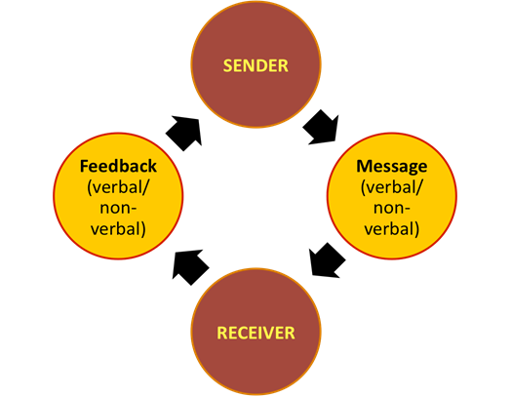
Concepts and Principles of Team Movement
Stay Together as Much as Possible
540° of Cover Around the Team
Communication
Cover the Angles
Threshold Evaluation
Speed of Movement

Slide 54
Two Man Movement

Slide 55
Tethered Movement (Two-Man)
Strengths:
Easy to cover all angles, especially when stationary
Small target signature
Can move quickly using touch indexing to determine speed
Weaknesses:
Weapon deployed using one hand
Responders in direct line with each other from front or rear hostile fire
Gap in coverage to sides

Slide 56
Side By Side Movement (Two-Man)
Strengths:
Both hands on weapon system
Responders not directly in line from back or front
Limited to no gap in coverage to the sides
Weaknesses:
Difficult to cover angles when stationary in a linear danger area (such as a hallway)
Larger target signature
Difficulty in moving quickly

Slide 57
Three Man Movements

Slide 58
Tethered Movement (Three-Man)
Strengths:
Easy to cover all angles, especially when stationary
Smaller target signature
Can move quickly using touch indexing to determine speed
Ballistic protection to rear guard from the front
Weaknesses:
Weapon deployed using one hand (rear guard)

Slide 59
Side By Side Movement (Three-Man)
Strengths:
Both hands on the weapon system (all positions)
Responders not directly in line from back or front
Limited to no gap in coverage to the sides
Weaknesses:
Difficult to cover angles when stationary in a linear danger area (such as a hallway)
Larger target signature
Difficulty moving quickly

Slide 60
Four Man Movement Techniques

Slide 61
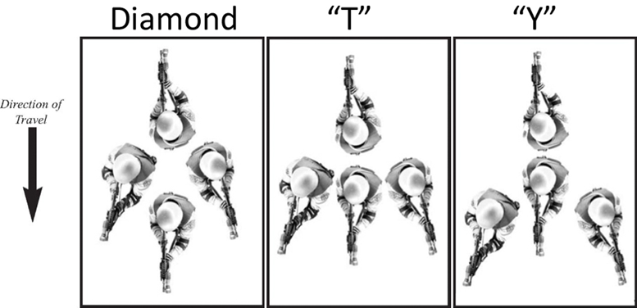
Four Man Movement Techniques
Point Position
Left Cover Position
Right Cover Position
Rear Guard Position
Team Leader/Long Gun

Slide 62
Alternate Four Man Movement Techniques

Slide 63
Diamond Movement
Strengths:
Easy to cover all angles, especially when stationary
Can flex into limited space environments
Can move quickly using touch indexing to determine speed
Ballistic protection to rear guard from the front
Weaknesses:
Weapon deployed using one hand (rear guard)
The point position is exposed if left or right cover fails to move up and cover from the side a during deliberate speed entry
If not disciplined, priority of fire issues can arise

Slide 64
“T” Movement
Strengths:
Reduces priority of fire issues to the front—all responders are in line
Left and right cover can cross cover angles to the front
Limited to no gap in coverage to the sides
Weaknesses:
Larger target signature
More difficult to move rapidly and maintain integrity of the “T”
Requires more complex communication (cross cover/switch)

Slide 65
“Y” Movement
Strengths:
Excellent movement technique when clearing intersecting hallways
Left and right cover can maximize cross cover angles to the front
Weaknesses:
Priority of fire issues if the point does not move up online with left and right cover
More difficult to move rapidly and maintain integrity of the “Y”
Requires more complex communication (cross cover/switch)

Slide 66
Five Man Movement Techniques

Slide 67
Double Rear Guard Movement
Strengths:
Overlapping fields of fire around the team
Cross cover to the rear if the team becomes stationary
Can move quickly using touch indexing to determine speed
Increased ballistic protection around the team
Weaknesses:
Weapon deployed using one hand (rear guards)
The point position is exposed if left or right cover fails to move up and cover from the side during deliberate speed entry
If not disciplined, priority of fire issues can arise

Slide 68
Special Skill/Knowledge Movement
Strengths:
One person controls the team using overall situational awareness
Frees up a responder to use a radio to stay in communication with other responders operating in the same environment
The responder with special skill/knowledge can direct the team as it moves to close distance with the suspects
Increased ballistic protection around the team
Weaknesses:
Weapon deployed using one hand (rear guard)
Special skill/knowledge position must maintain discipline to limit priority of fire issues

Slide 69
Enabling Objectives Part II-D
Demonstrate safe weapons handling skills
Demonstrate methods for setting up for a room entry as a solo responder and in a team of up to five responders
Demonstrate non verbal communication skills prior to room entry
Demonstrate room entry techniques as a solo responder and in a team of up to five responders
Discuss and demonstrate team maintenance and the planning process prior to leaving a secure room
Discuss and demonstrate the need for additional responders (support) within a room
Discuss the room entry principles of speed, surprise, and violence of action
Discuss and demonstrate points of domination and fields of fire within a room
Discuss and demonstrate the importance of communication within a room
Identify, discuss, and demonstrate the tactical room entry philosophy of going to the “known” first
Identify, discuss, and demonstrate the tactical room entry philosophy of going to the “unknown” first

Slide 70
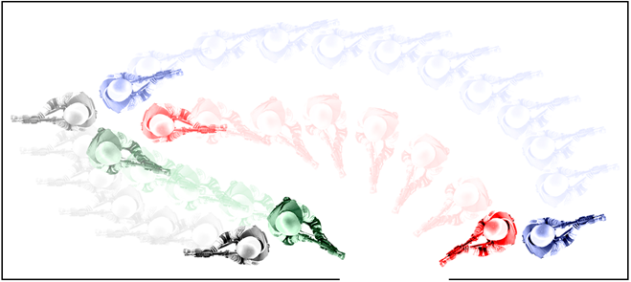
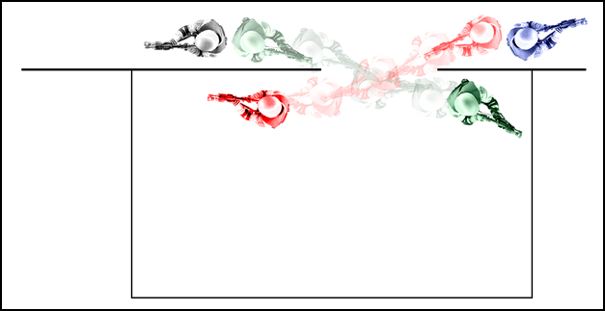
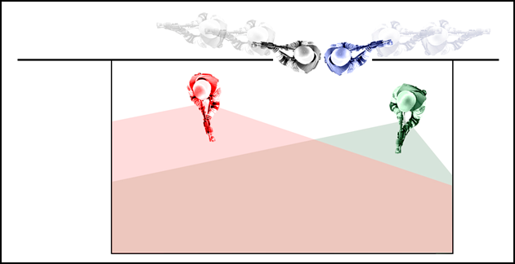
Setting Up for Room Entry
Communication
Positioning

Slide 71
Principles of Room Entry
The Element of Surprise
Speed
Violence of Action

Slide 72
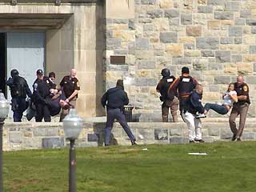
Final Words
This is only an introduction to the topic of prevention and response to school based active shooter/killer incidents.
Reality based training and exercises should be an ongoing part of police training.

Slide 73
References/Resources
Lt. Col. Dave Grossman http://www.warriorsciencegroup.com/
John Giduck, Archangel Group Ltd. http://archangelgroup.org/content_main/index.php
Advance Law Enforcement Rapid Response Training, http://alerrt.org/
Kenneth R. Murray, “Training at the Speed of Life” http://www.armiger.net/
Tony Blauer, http://www.tonyblauer.com/
http://www.denvergov.org/HomePage/CERT/tabid/426128/Default.aspx
http://www.crisisconsultantgroup.com/wp-content/uploads/2010/09/Active-Shooter-Response-Training-Banner.jpg
http://www1.ben.edu/resources/publicsafety/Police_Training.asp

